Slide 1
Swarming behaviour in predator-prey model
Collective behaviour course research seminar report
Ariana Kržan, Tina Brdnik, and Vito Levstik

Slide 2
Predator–prey
survival pressure is sufficient to evolve swarming behaviors
01.
02.
Emergence of swarming behaviours
Swarming
Appears in many species and is hypothesized to help prey in many ways.
Striking example of collective animal behaviour.
03.
04.
Project inspiration
Extension
From the work of Li et al. (2023)
Recreating the model, adding obstacles and new species.

Slide 3
Methods
01. Environment Setup
03. Reinforcment Learning Framework
02. Agent Dynamics, types and behaviours
04. Verification

Slide 4
Environment Setup
2D environment
Agents reappear on the opposite side, when crossing a boundary
No physical borders
Adding obstacles

Slide 5
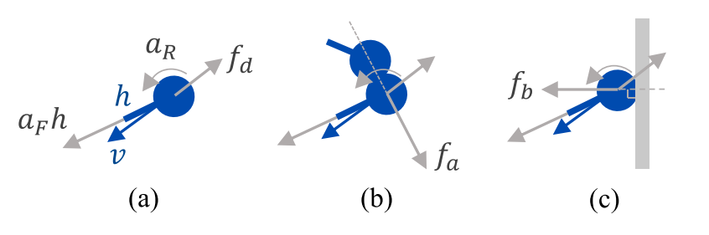
Active forces
Agent Dynamics
Forward Propulsion
Rotational Force
Passive forces
Dragging Force
Elastic Forces Between Agents

Slide 6
Prey
Agent Types
Aims to survive
Negative rewards for being caught
Predators
Pursue and catch prey
Positive and negative rewards
Super Predators
Aims to pursue predators
Real world food chain

Slide 7
Reinforcement Learning Framework
Uses an algorithm (MADDPG, PPO)
Reward structure
  +1/-1 if caught
  Cost of movement :
  −0.01|aF | − 0.1|aR|
  Toggable negative reward for obstacle collision

Slide 8


Verification
Degree of Sparsity (DoS)
Degree of Alignment (DoA)
measures the spatial aggregation of agents, capturing how densely the agents cluster
together.
quantifies the alignment of the agents’ headings, assessing how consistently agents move in the same direction

Slide 9
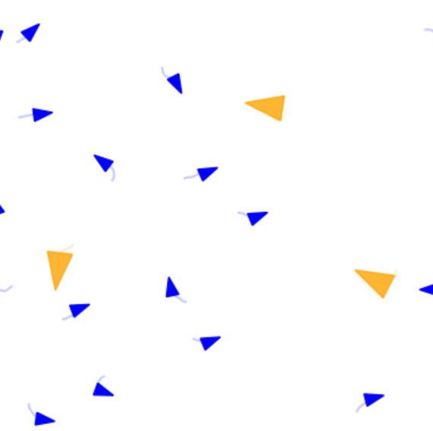
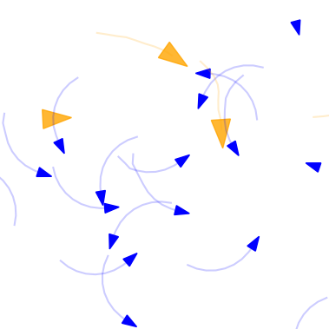
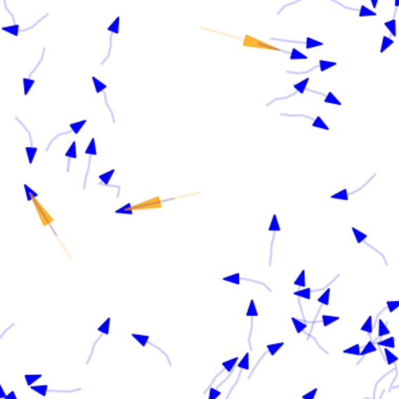
Results
First attempt
Basic implementation
Agent forces
RL
Prey
Predators
Parameters from the article
Environment
Passive forces
Active forces
MADDPG
Training for 2000 episodes

Slide 10
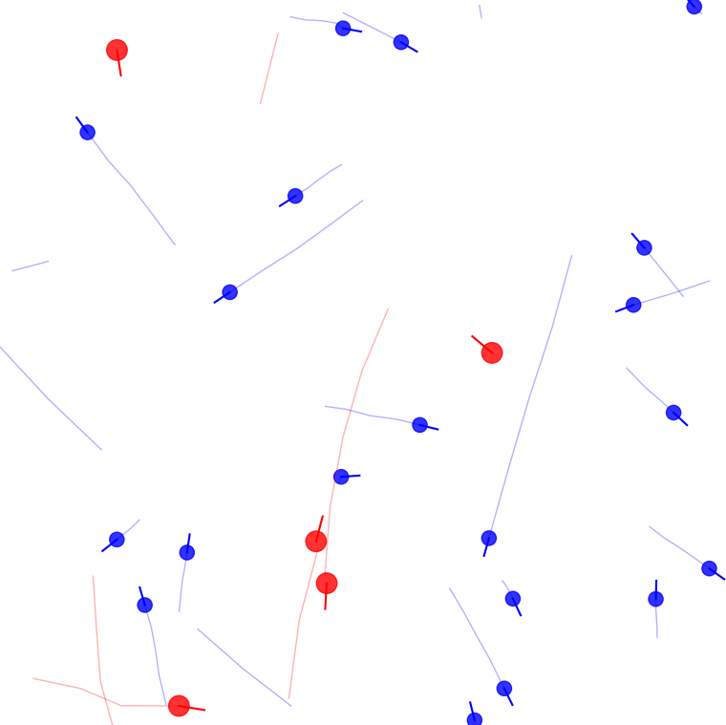
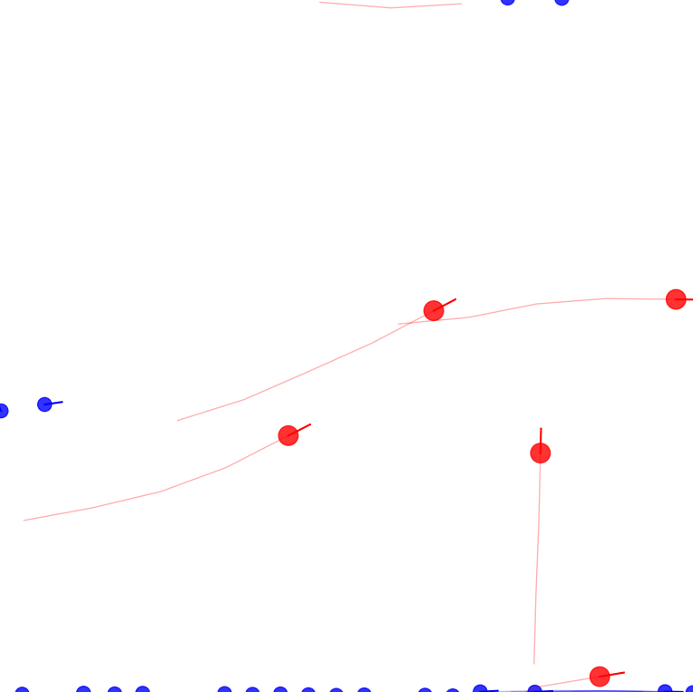
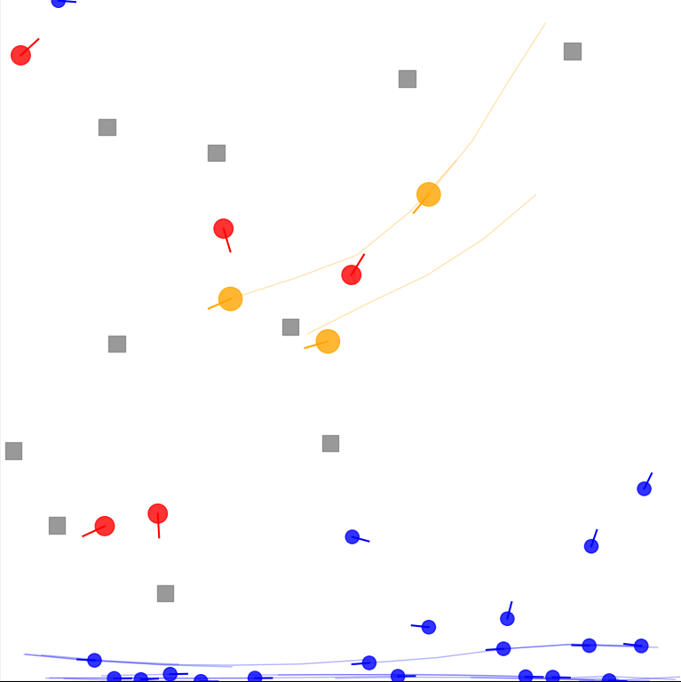
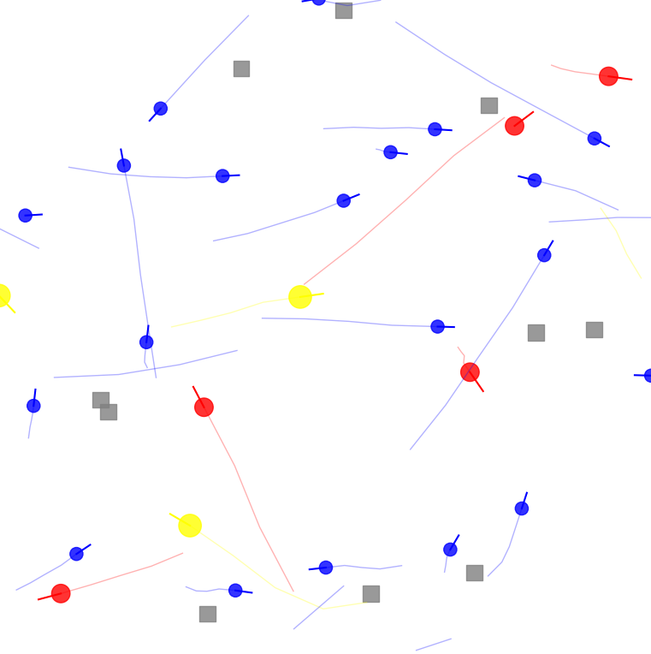
Results
Second attempt
2 species before and after training
3 species with obstacles before and after training

Slide 11
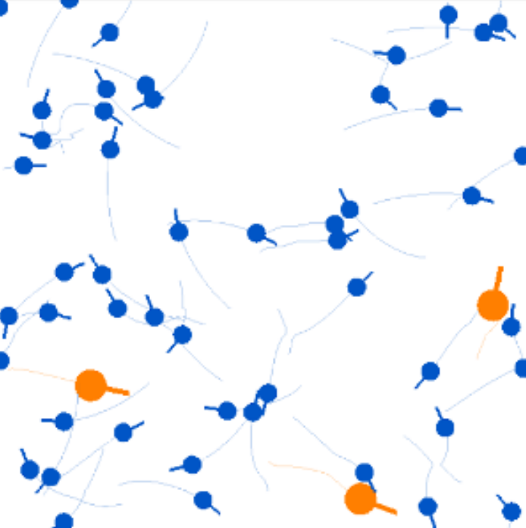
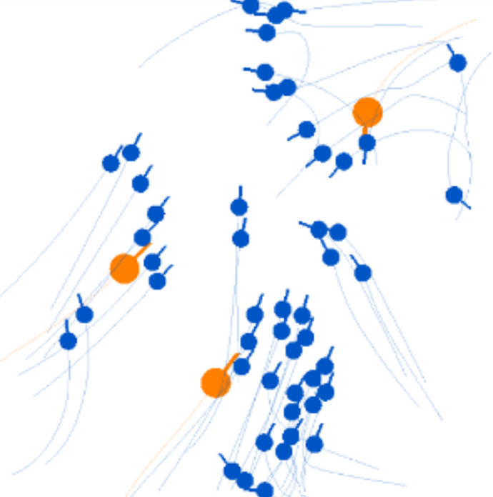
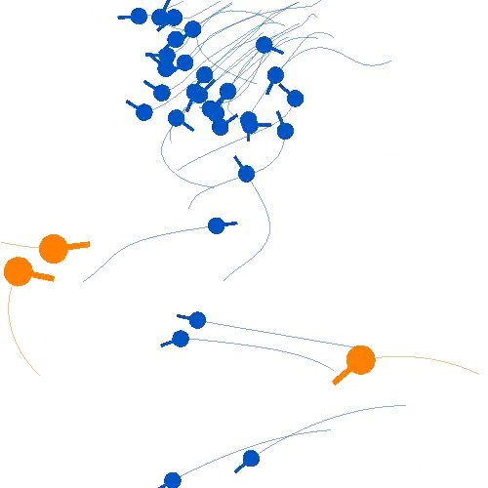
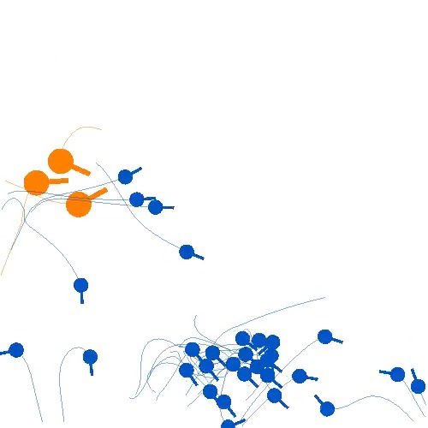
Results
Working on article’s model
Code is too complex
Contacted authors for help
Ran simulations and created DoS and DoA graphs for further comparison

Slide 12
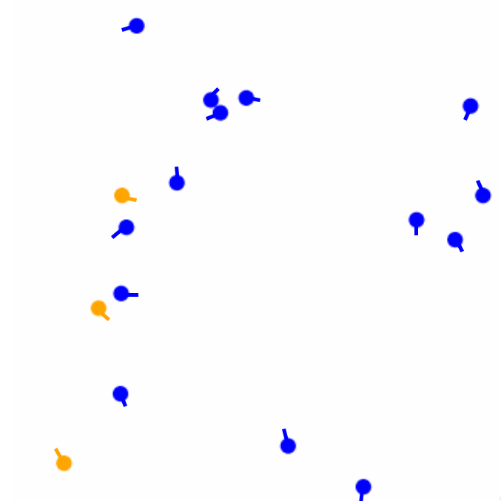
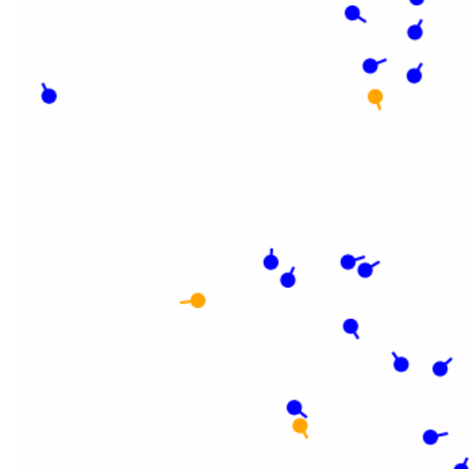
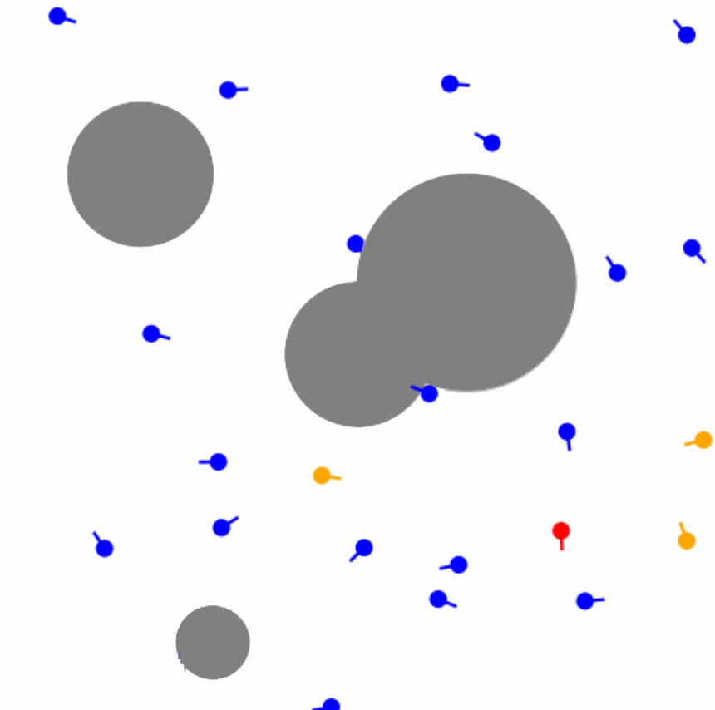
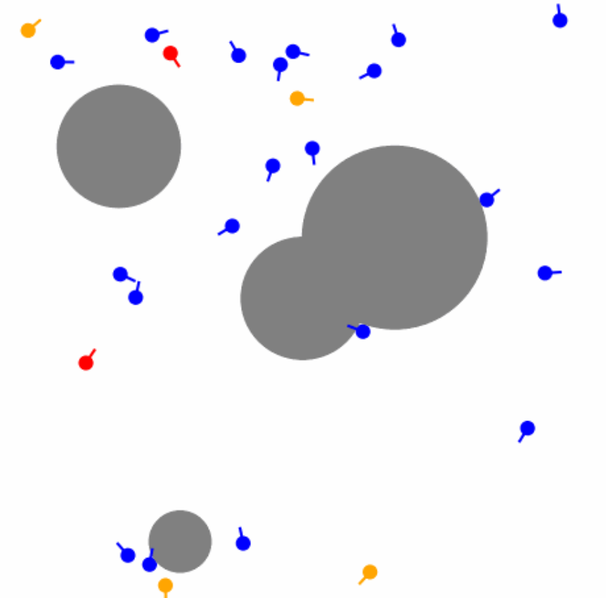
Results
Final results
2 species before and after training
3 species with obstacles before and after training

Slide 13
Discussion
Mixed results
Implemented several models
Low DoS, struggled with DoA
Successfully added obstacles and a new species
Contacted authors several times
PPO most promising

