Slide 1
Modeling Social Distancing with Reinforcement Learning
Leon Todorov
Nejc Ločičnik
Andraž Zrimšek
Igor Nikolaj Sok

Slide 2
Motivation
Why model social distancing?
Understanding adaptive behaviors in disease mitigation.
Insights into epidemiology, robotics, and swarm intelligence.
Why It Matters?
Public Health: COVID-19 highlighted the critical role of distancing.
Understanding how such behaviors emerge can inform public health strategies and advance adaptive system designs.
Applications range from epidemiology to swarm robotics and autonomous systems.

Slide 3
Starting goals
Simulate social distancing behaviors using reinforcement learning (RL).
Explore how agents adapt interactions to minimize disease spread.

Slide 4
Challenges
Source Code Integration: A significant challenge was getting the author's original source code working, which required extensive debugging and adaptation to fit the project’s specific needs.
Reward System Design: Finding an effective balance between reward and penalty structures to encourage desired behaviors.
Slow Feedback Loop: The training and evaluation process was slow, which made it challenging to iteratively refine the model and observe the effects of adjustments in real-time.

Slide 5
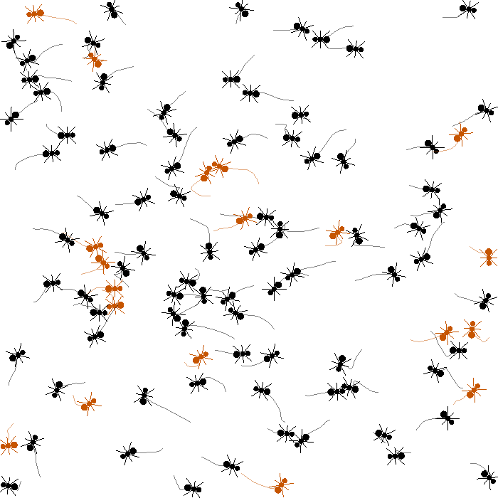
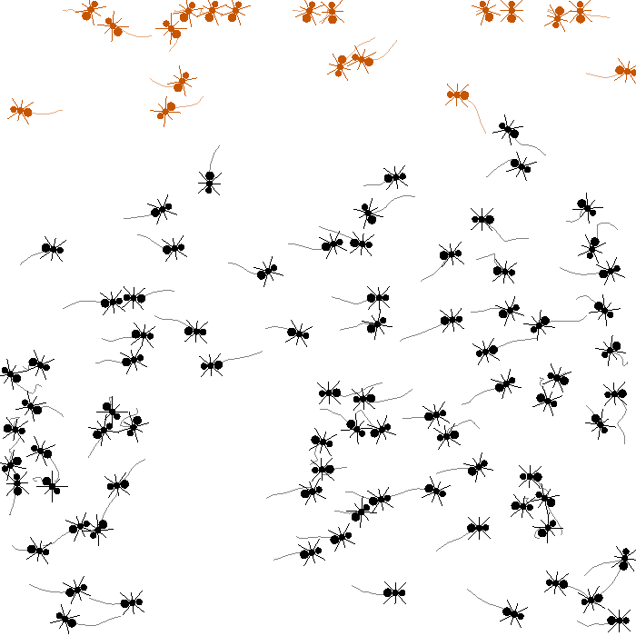
Results

Slide 6
Lessons Learned
Observation space: Inclusion of additional parameters in observation
Interactions: Exploration of more complex interactions
Visualization: More visualization tools, visualization of spread and agent death
RL model: Test different RL algorithms and parameters

Slide 7
Discussion
Validation: Social distancing can emerge naturally through RL with simple reward structures
Insights into the model: Network statistics provide useful insights into disease spread in populations
Adaptability: Model highly adaptable, agents exhibit disease spread limiting behavior in varied scenarios
Future work: Explore more complex spread dynamics and different infection limiting behavior and application of the model to larger real world scenarios

