Slide 1
Multitier architectures for scalability and adaptation

Slide 2
Multitier
What it is? Basic understanding
Commercial design patterns
Exploiting the advantages of containers (fast operation, lightweight)
File Upload scenario, network related aspects
Orchestration in view of Quality of Service and Quality of Experience
More complex custom designed applications with requirements for monitoring and orchestration (adaptation)

Slide 3
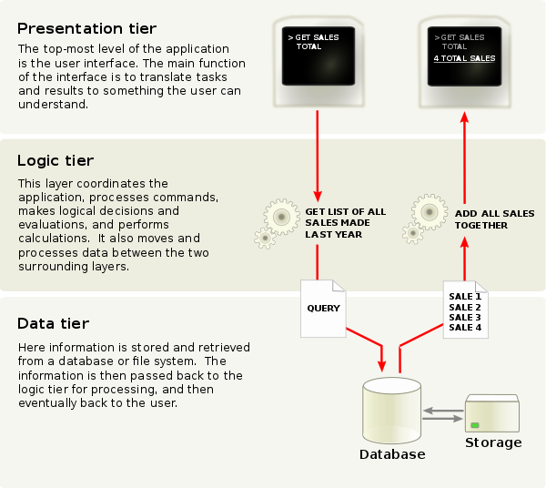
Multitier

Slide 4
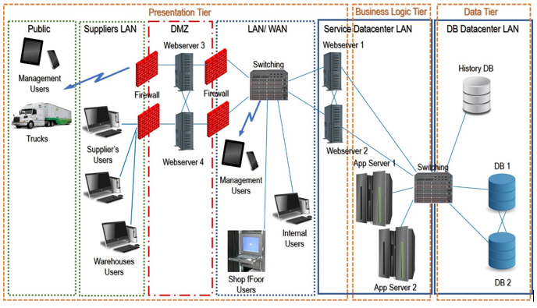
More complex business applications
https://www.bmc.com/blogs/n-tier-architecture-tier-2-tier-3-and-multi-tier-explained/

Slide 5
Commercial design patterns
https://docs.bitnami.com/google-templates/singletier-vs-multitier/

Slide 6
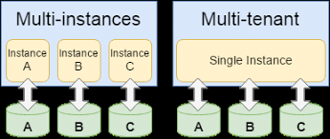
Multi-tenant vs. multi-instance

Slide 7
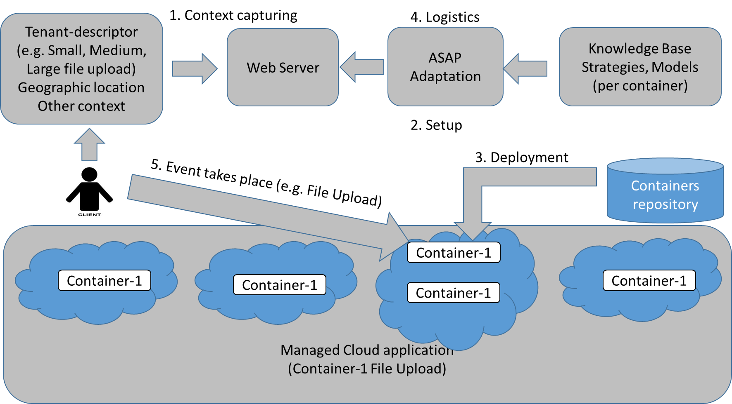
File Upload @ Edge Scenario, container is started for single usage instance (one file upoload)

